Slide 1


Project Name: Commercial Bank International Travel Card
Presenter: Ravi Kaushik and Pankaj Soni
Trainer: Annu Sharma
Mentor : Prakash Subramaniam and Shikha Pandey

Slide 2
Problem Statement
This commercial bank’s international travel card is very popular with not just its own customers, but also many other bank customers. Business team is keen to provide various card usage analysis as dashboard to consumers that shows consumer spend and allows users to search easily.
Could your team help think and create personalized dashboard that consumer can access from any of his / her devices/computers?

Slide 3
Design Thinking Steps Involved
Empathize
Define
Ideate
Prototype
Test
Gathered information through observation and first-hand experience.
Helped in understanding the emotions involved
Narrowed it down and listed the specific problem we’re aiming to solve.
Worked within the time limit, brainstormed the ideas among team.
Designed a prototype to test our solution by putting our ideas into action.
Tested our ideas and collected some of the feedbacks.

Slide 4
Ethnographic Research
How often do you travel overseas?
When you last travelled overseas can you recall what methods you used for making purchases whilst you were overseas?
If you have not used a prepaid travel card, why not?
Do you recall what brand(s) of prepaid travel card you used?
Approximately how much money did you load (in total) onto your prepaid travel card?
How satisfied were you with the travel card?
What problems you faced while using the travel card?
Do you plan to use the prepaid travel card again on future overseas trips?

Slide 5
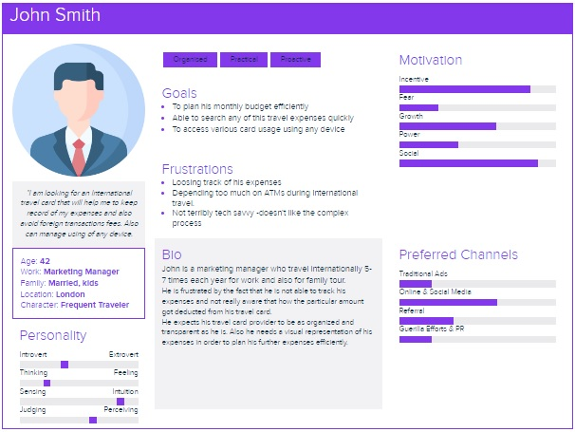
User’s Persona

Slide 6
Ideate
Personalized Dashboard
Responsiveness
Expense Search Functionality
Display Card Usage Features
Customer Support
Travel Note
Easy and Secure Transaction
Currency Exchange

Slide 7



Technologies Used
  HTML5
  CSS5
  Bootstrap
  JavaScript
  React Js
  Spring Boot
  Microservices Patterns
  JWT Tokens
  Swagger
  MySQL
  MongoDB
FRONTEND
DATABASE
BACKEND

Slide 8
Future Scope:
Expand the card usage for other countries as well
Implement reward points functionality based on the transactions
Generate more detailed dashboard analysis report
Chatbot to solve customer queries fast
User friendly alerts : Security, offers and transaction
Add balance to travel card

Slide 9
Prototype
User
Home page Module
JWT
Tokens
Microservices
Database
Register Module
API Gateway
Credit Card
User Service
MySQL
Login Module
Contact us
Service
MongoDB
Dashboard Module
Contact us Module
Service Discovery

Slide 10
Database Table Diagram
Credit card
User
Transaction
Creditcard_id
Bills
Food
Movie
Name
Shopping
User_id
Address
Card
Confirm Password
User_id
Amount
Description
Date
Type
Travel Notes
Contact us
TravelNotes_id
Date
Todate
Contacts_id
Name
Email
Subject
Message

Slide 11

Thank you

